Slide 1

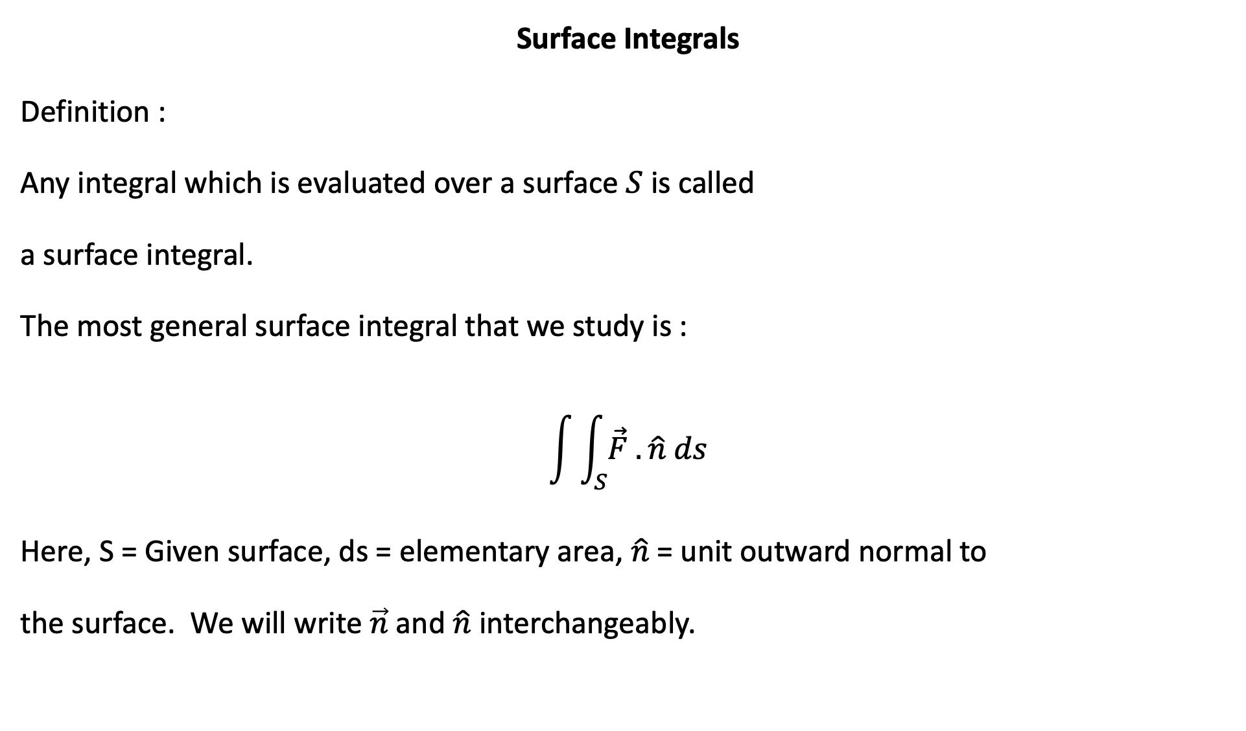


Z
Surface Integrals
Definition :
Any integral which is evaluated over a surface $S$ is called
a surface integral.
The most general surface integral that we study is :
$$\int{\int_{S}{\vec{F} . \hat{n} ds}}$$
Here, S = Given surface, ds = elementary area, $\hat{n}$= unit outward normal to
the surface. We will write $\vec{n}$and $\hat{n}$interchangeably.
$\hat{n}$
S
$$\vec{F}$$
$$dS$$
Y
O
X

Slide 2

Physical meaning of $\int{\int_{S}{\vec{F} . \hat{n} ds}}$:
“ Flux” ( amount of fluid passing normally through a surface S in unit time) over the
surface S , if the rate of flow at any point is governed by the vector $\vec{F}$ .

Slide 3
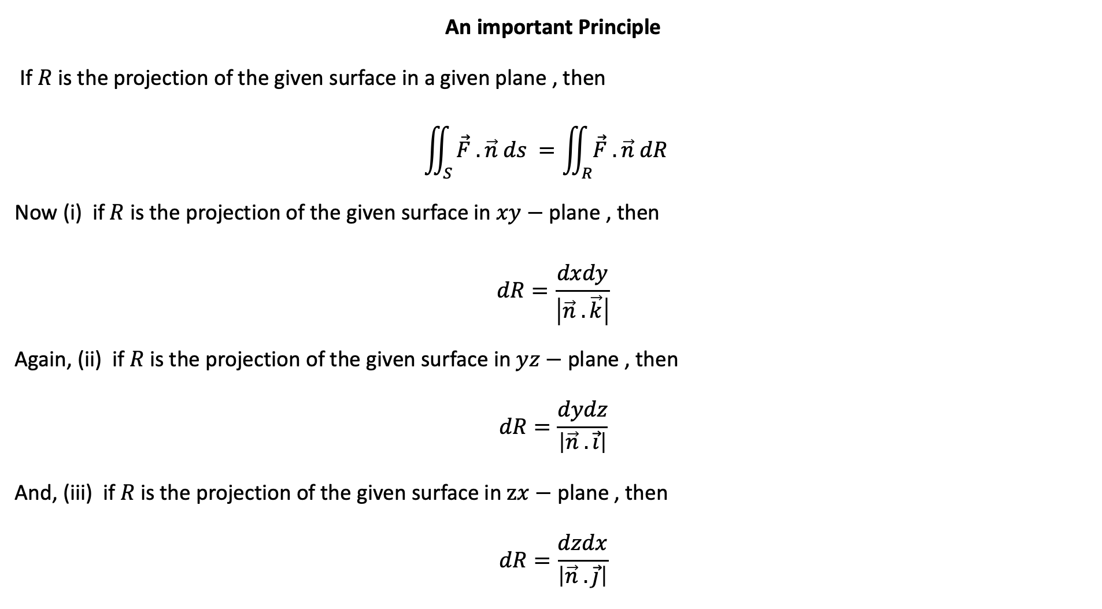
An important Principle
If $R$ is the projection of the given surface in a given plane , then
$$\iint_{S}{\vec{F} . \vec{n} ds =\iint_{R}{\vec{F} . \vec{n} dR }}$$
Now (i) if $R$ is the projection of the given surface in $xy−$ plane , then
$$dR=\frac{dxdy}{\left|\vec{n} . \vec{k}\right|}$$
Again, (ii) if $R$ is the projection of the given surface in $yz−$ plane , then
$$dR=\frac{dydz}{\left|\vec{n} . \vec{i}\right|}$$
And, (iii) if $R$ is the projection of the given surface in $zx−$ plane , then
$$dR=\frac{dzdx}{\left|\vec{n} . \vec{j}\right|}$$

Slide 4

Calculation of $\vec{n}$
Denote equation of surface, $S$, by $φ≡0 .$ Then ,
Normal to the surface is : $∇ φ$
Then unit normal to the surface $S$ is given by :
$$\vec{n}= \frac{∇ φ}{\left|∇ φ\right|}$$

Slide 5



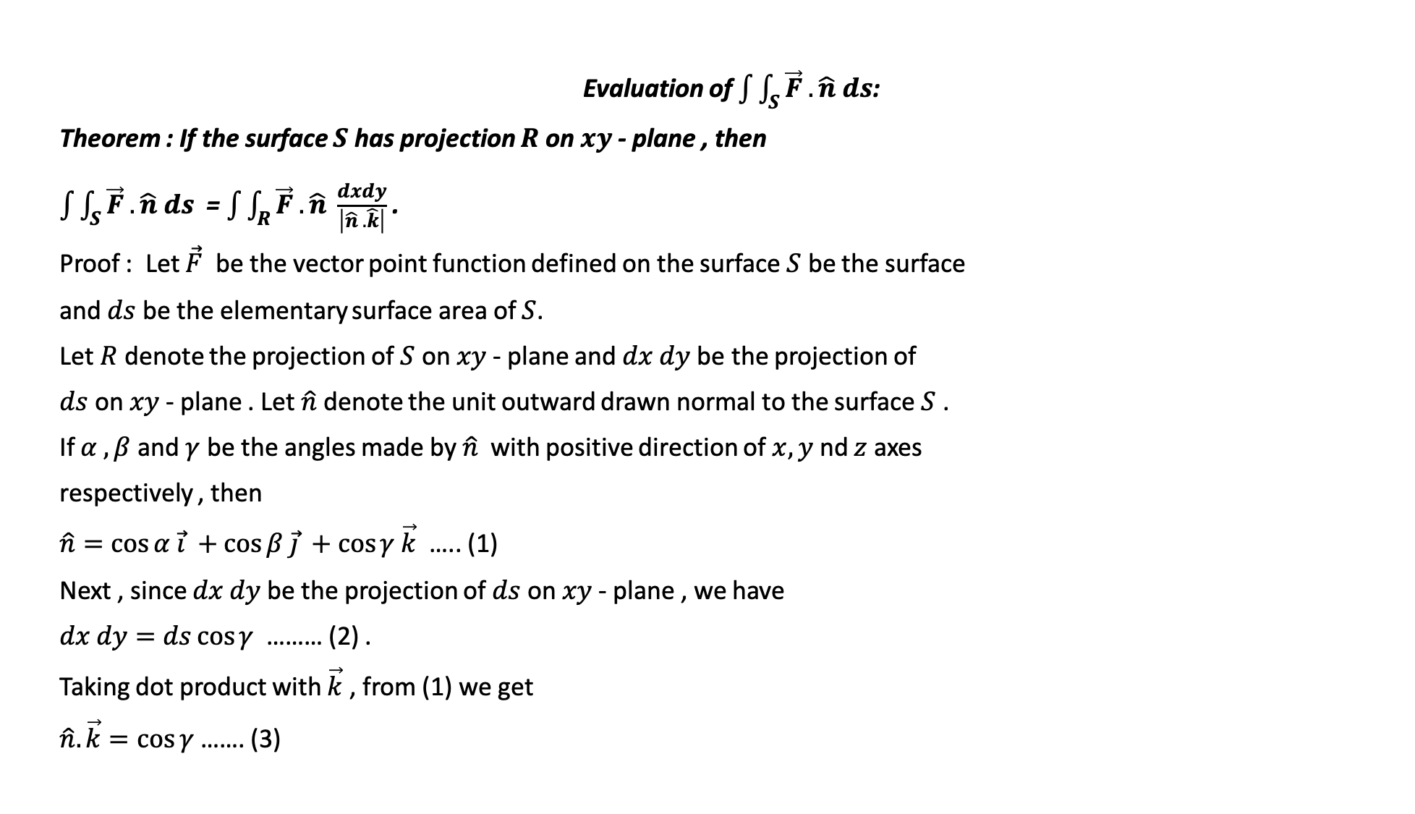






Evaluation of $\int{\int_{S}{\vec{F} . \hat{n} ds}}$:
Theorem : If the surface $S$ has projection $R$ on $xy$- plane , then
$\int{\int_{S}{\vec{F} . \hat{n} ds}}$ = $\int{\int_{R}{\vec{F} . \hat{n} \frac{dxdy}{\left|\hat{n} . \hat{k}\right|}}}$ .
Proof : Let $\vec{F}$ be the vector point function defined on the surface $S$ be the surface
and $ds$ be the elementary surface area of $S$.
Let $R$ denote the projection of $S$ on $xy$- plane and $dx dy$be the projection of
$ds$ on $xy$- plane . Let $\hat{n}$ denote the unit outward drawn normal to the surface $S$ .
If $α , β$ and $γ$ be the angles made by $\hat{n}$ with positive direction of $x,y$ nd $z$ axes
respectively , then
$\hat{n}=\cos{α \vec{i} +\cos{β \vec{j} +\cos{γ \vec{k}}}}$ ….. (1)
Next , since $dx dy$be the projection of $ds$ on $xy$- plane , we have
$dx dy=ds\cos{γ }$ ……… (2) .
Taking dot product with $\vec{k}$ , from (1) we get
$\hat{n}.\vec{k}=\cos{γ}$ ……. (3)
$$\hat{n}$$
$$Z$$
$$s$$
$$ds$$
$X$
$O$
$$dxdy$$
$$R$$
$$Y$$

Slide 6
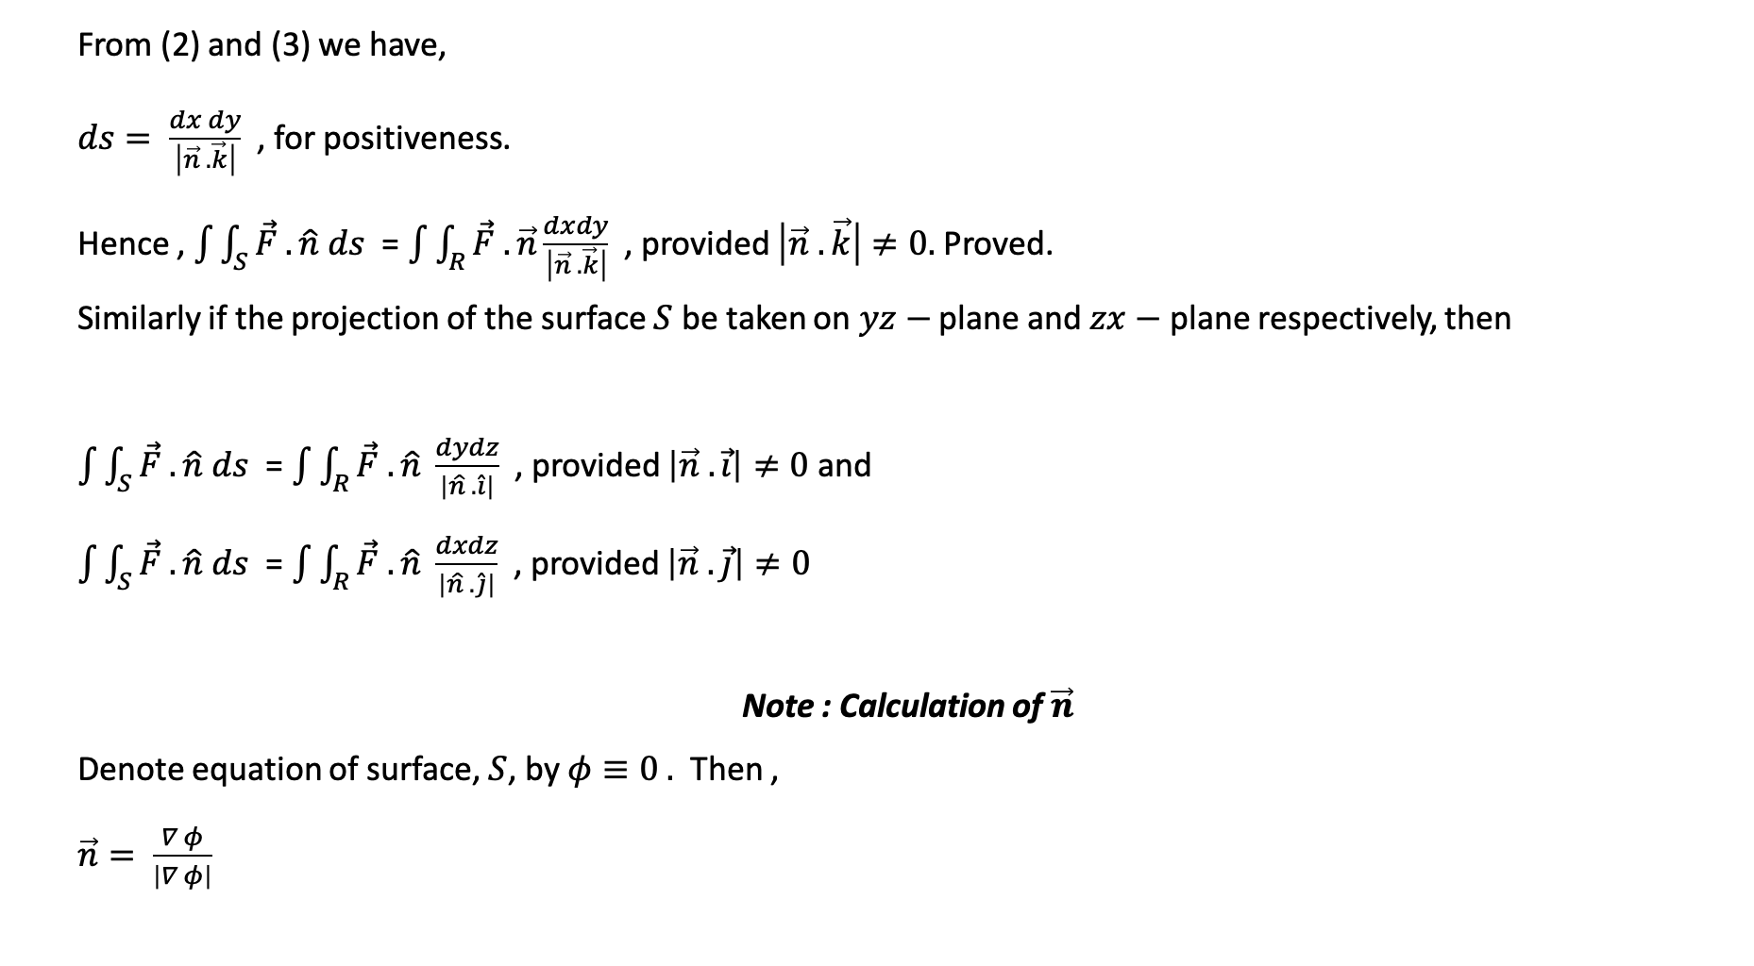
From (2) and (3) we have,
$ds= \frac{dx dy}{\left|\vec{n} . \vec{k}\right|}$ , for positiveness.
Hence , $\int{\int_{S}{\vec{F} . \hat{n} ds}}$ = $\int{\int_{R}{\vec{F} . \vec{n}\frac{dxdy}{\left|\vec{n} . \vec{k}\right|}}}$ , provided $\left|\vec{n} . \vec{k}\right|≠0.$Proved.
Similarly if the projection of the surface $S$ be taken on $yz−$ plane and $zx−$ plane respectively, then
$\int{\int_{S}{\vec{F} . \hat{n} ds}}$ = $\int{\int_{R}{\vec{F} . \hat{n} \frac{dydz}{\left|\hat{n} . \hat{i}\right|}}}$ , provided $\left|\vec{n} . \vec{i}\right|≠0$ and
$\int{\int_{S}{\vec{F} . \hat{n} ds}}$ = $\int{\int_{R}{\vec{F} . \hat{n} \frac{dxdz}{\left|\hat{n} . \hat{j}\right|}}}$ , provided $\left|\vec{n} . \vec{j}\right|≠0$
Note : Calculation of $\vec{n}$
Denote equation of surface, $S$, by $φ≡0 .$ Then ,
$\vec{n}= \frac{∇ φ}{\left|∇ φ\right|}$

Slide 7

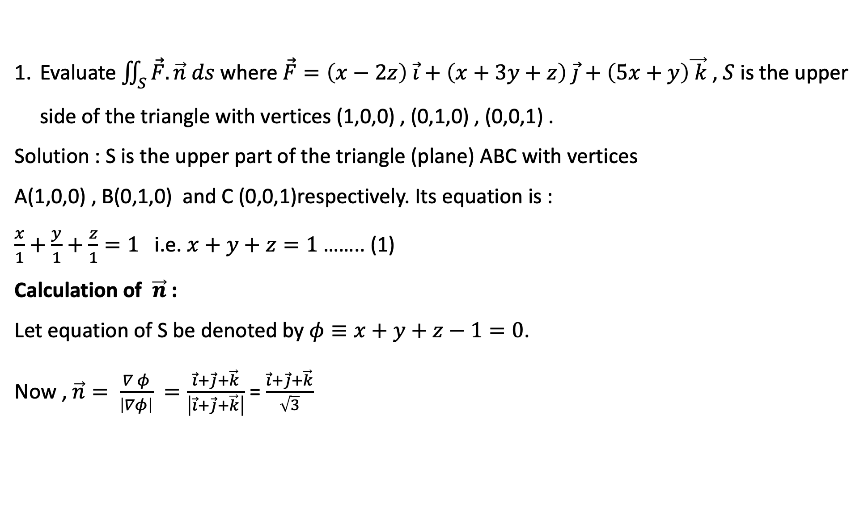
Evaluate $\iint_{S}{\vec{F}.\vec{n} ds }$where $\vec{F}=\left(x−2z\right) \vec{i}+\left(x+3y+z\right) \vec{j}+\left(5x+y\right)\vec{ k}$, $S$ is the upper side of the triangle with vertices (1,0,0) , (0,1,0) , (0,0,1) .
Solution : S is the upper part of the triangle (plane) ABC with vertices
A(1,0,0) , B(0,1,0) and C (0,0,1)respectively. Its equation is :
$\frac{x}{1}+\frac{y}{1}+\frac{z}{1}=1$ i.e. $x+y+z=1$ …….. (1)
Calculation of $\vec{n}$ :
Let equation of S be denoted by $φ≡x+y+z−1=0$.
Now , $\vec{n}= \frac{∇ φ}{\left|∇φ\right|} =\frac{\vec{i}+\vec{j}+\vec{k}}{\left|\vec{i}+\vec{j}+\vec{k}\right|}$ = $\frac{\vec{i}+\vec{j}+\vec{k}}{\sqrt{3}}$
Z
C(0,0,1)
$$S≡φ$$
O
Y
B(0,1,0)
R
A(1,0,0)
X

Slide 8
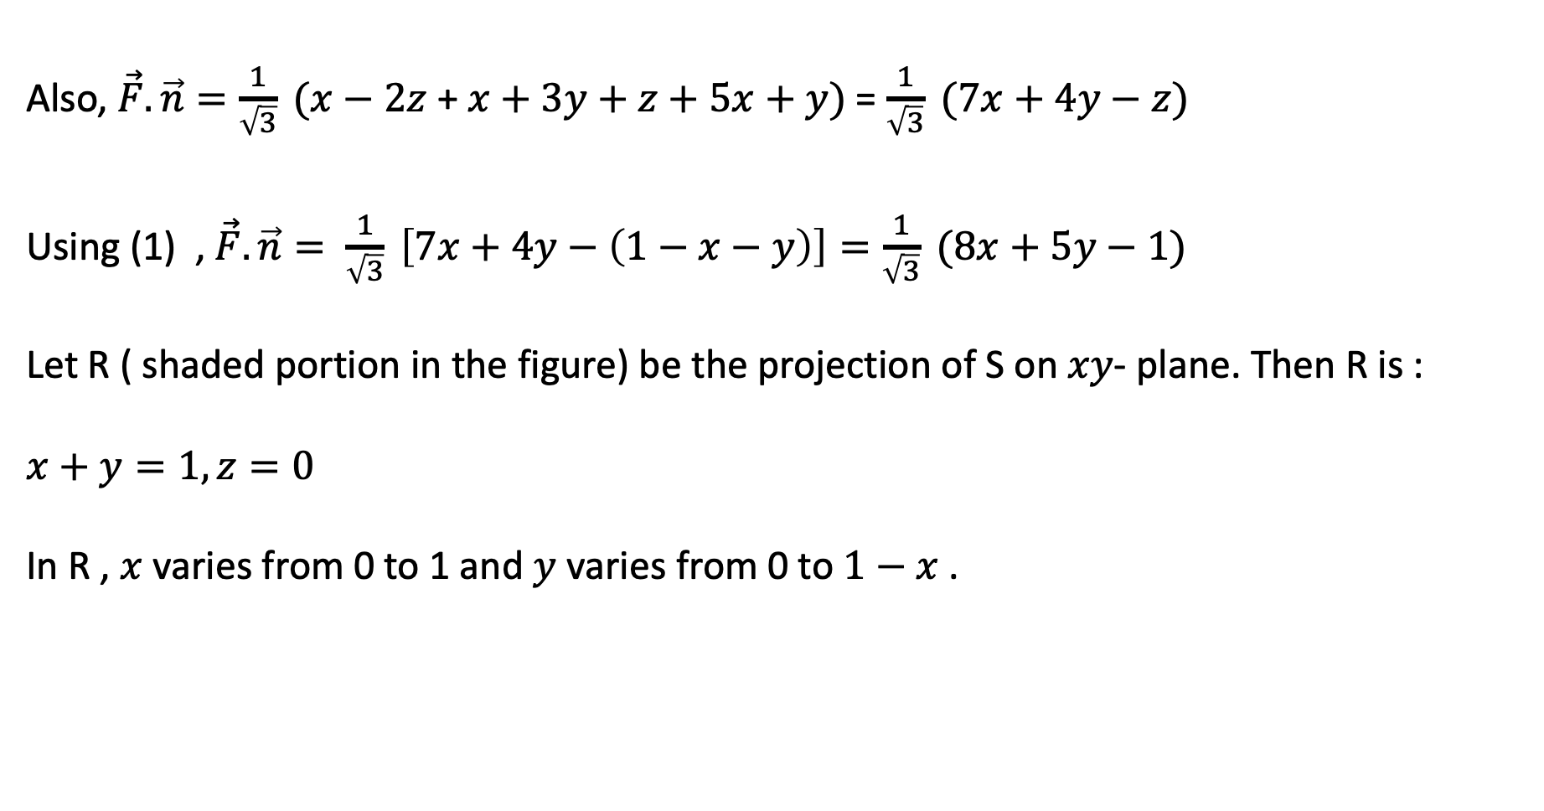
Also, $\vec{F}.\vec{n}=\frac{1}{\sqrt{3}} (x−2z$ + $x+3y+z+5x+y)$= $\frac{1}{\sqrt{3}} (7x+4y−z)$
Using (1) , $\vec{F}.\vec{n}= \frac{1}{\sqrt{3}} \left[7x+4y−\left(1−x−y\right)\right]=\frac{1}{\sqrt{3}} (8x+5y−1)$
Let R ( shaded portion in the figure) be the projection of S on $xy$- plane. Then R is :
$x+y=1, z=0$
In R , $x$ varies from 0 to 1 and $y$ varies from 0 to $1−x$ .

Slide 9

$∴\int{\int_{S}{\vec{F} . \hat{n} ds}}$ = $\int{\int_{R}{\vec{F} . \hat{n} \frac{dxdy}{\left|\vec{n} . \vec{k}\right|}}}$
= $\int_{x=0}^{1}{\int_{y=0}^{1−x}{\frac{1}{\sqrt{3}} (8x+5y−1) \frac{dy dx}{\frac{1}{\sqrt{3}}}}}$ ; [ $∵\vec{n}.\vec{k}=\frac{1}{\sqrt{3}} \left(\vec{i}+\vec{j}+\vec{k}\right). \vec{k}=\frac{1}{\sqrt{3}}$ ]
= $\int_{x=0}^{1}{{\left[8xy+5 \frac{y^{2}}{2} −y\right]}_{y=0}^{1−x}} dx$
= $\int_{x=0}^{1}{[}8x\left(1−x\right)+\frac{5}{2} {\left(1−x\right)}^{2}−(1−x)] dx$

Slide 10
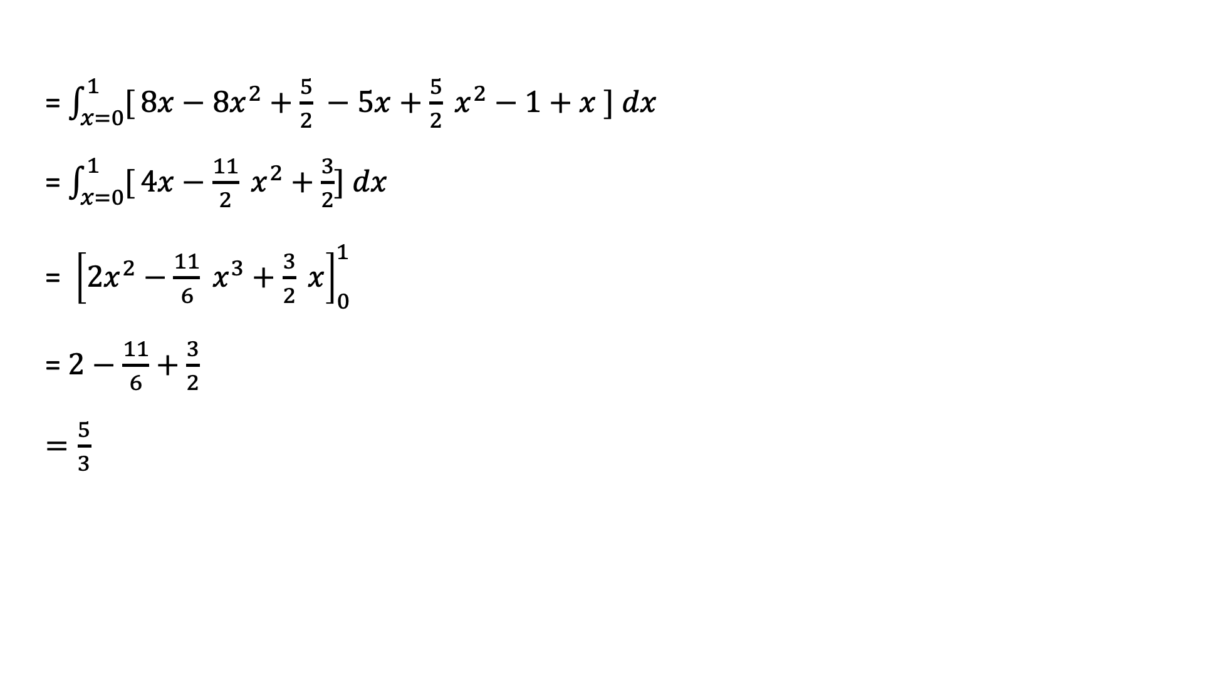
= $\int_{x=0}^{1}{[}8x−8x^{2}+\frac{5}{2} −5x+\frac{5}{2} x^{2}−1+x ] dx$
= $\int_{x=0}^{1}{[}4x−\frac{11}{2} x^{2}+\frac{3}{2}] dx$
= ${ \left[2x^{2}−\frac{11}{6} x^{3}+\frac{3}{2} x\right]}_{0}^{1}$
= $2−\frac{11}{6}+\frac{3}{2}$
$=\frac{5}{3}$

Slide 11
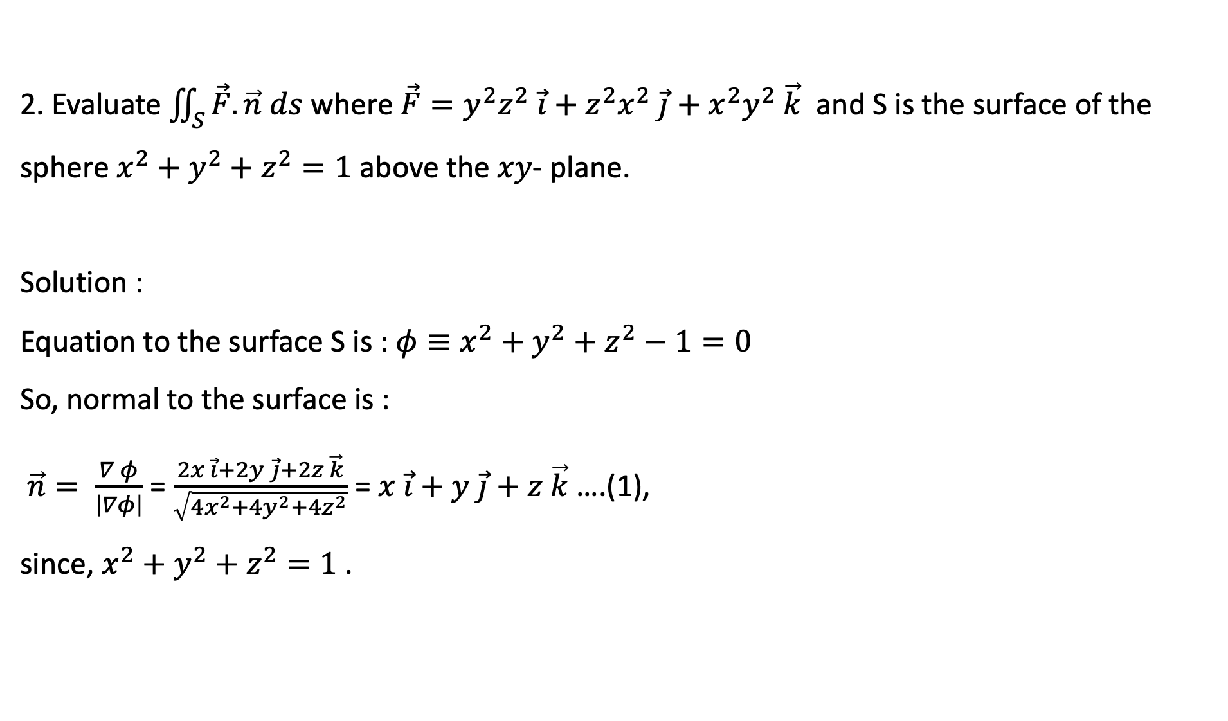
2. Evaluate $\iint_{S}{\vec{F}.\vec{n} ds }$where $\vec{F}=y^{2}z^{2} \vec{i}+z^{2}x^{2} \vec{j}+x^{2}y^{2} \vec{k}$ and S is the surface of the sphere $x^{2}+y^{2}+z^{2}=1$ above the $xy$- plane.
Solution :
Equation to the surface S is : $φ≡x^{2}+y^{2}+z^{2}−1=0$
So, normal to the surface is :
$\vec{n}= \frac{∇ φ}{\left|∇φ\right|}$ = $\frac{2x \vec{i}+2y \vec{j}+2z \vec{k}}{\sqrt{4x^{2}+4y^{2}+4z^{2}}}$ = $x \vec{i}+y \vec{j}+z \vec{k}$ ….(1),
since, $x^{2}+y^{2}+z^{2}=1$ .
Z
O
Y
R
X

Slide 12
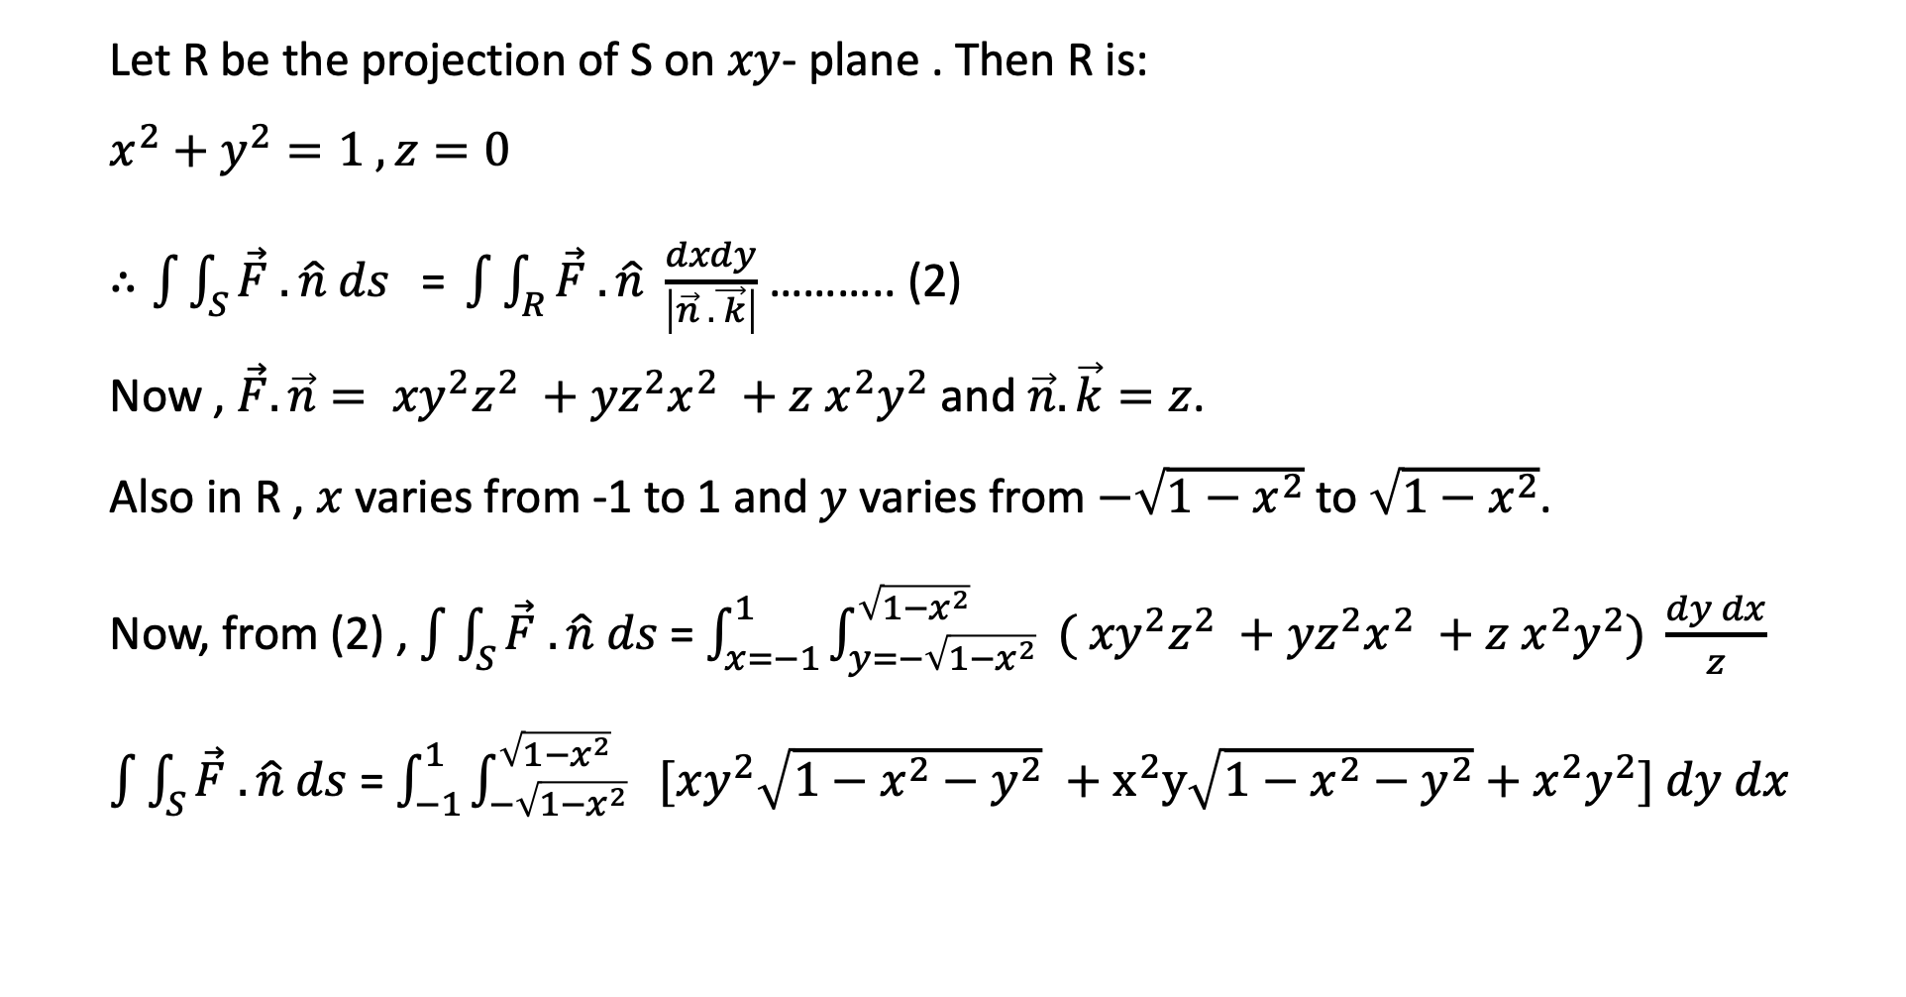
Let R be the projection of S on $xy$- plane . Then R is:
$x^{2}+y^{2}=1 , z=0$
$∴\int{\int_{S}{\vec{F} . \hat{n} ds}}\text{ = }\int{\int_{R}{\vec{F} . \hat{n} \frac{dxdy}{\left|\vec{n} . \vec{ k}\right|}}}$ ……….. (2)
Now , $\vec{F}.\vec{n}= {xy}^{2}z^{2} +{yz}^{2}x^{2} +{z x}^{2}y^{2}$ and $\vec{n}. \vec{k}=z$.
Also in R , $x$ varies from -1 to 1 and $y$ varies from $−\sqrt{1−x^{2}}$ to $\sqrt{1−x^{2}}$.
Now, from (2) , $\int{\int_{S}{\vec{F} . \hat{n} ds}}$ = $\int_{x=−1}^{1}{\int_{y=−\sqrt{1−x^{2}}}^{\sqrt{1−x^{2}}}{ (}}$ ${xy}^{2}z^{2} +{yz}^{2}x^{2} +{z x}^{2}y^{2}) \frac{dy dx}{z}$
$\int{\int_{S}{\vec{F} . \hat{n} ds}}$ = $\int_{−1}^{1}{\int_{−\sqrt{1−x^{2}}}^{\sqrt{1−x^{2}} }{ [xy^{2}\sqrt{1−x^{2}−y^{2}} }}+x^{2}y\sqrt{1−x^{2}−y^{2}}+x^{2}y^{2}] dy dx$

Slide 13
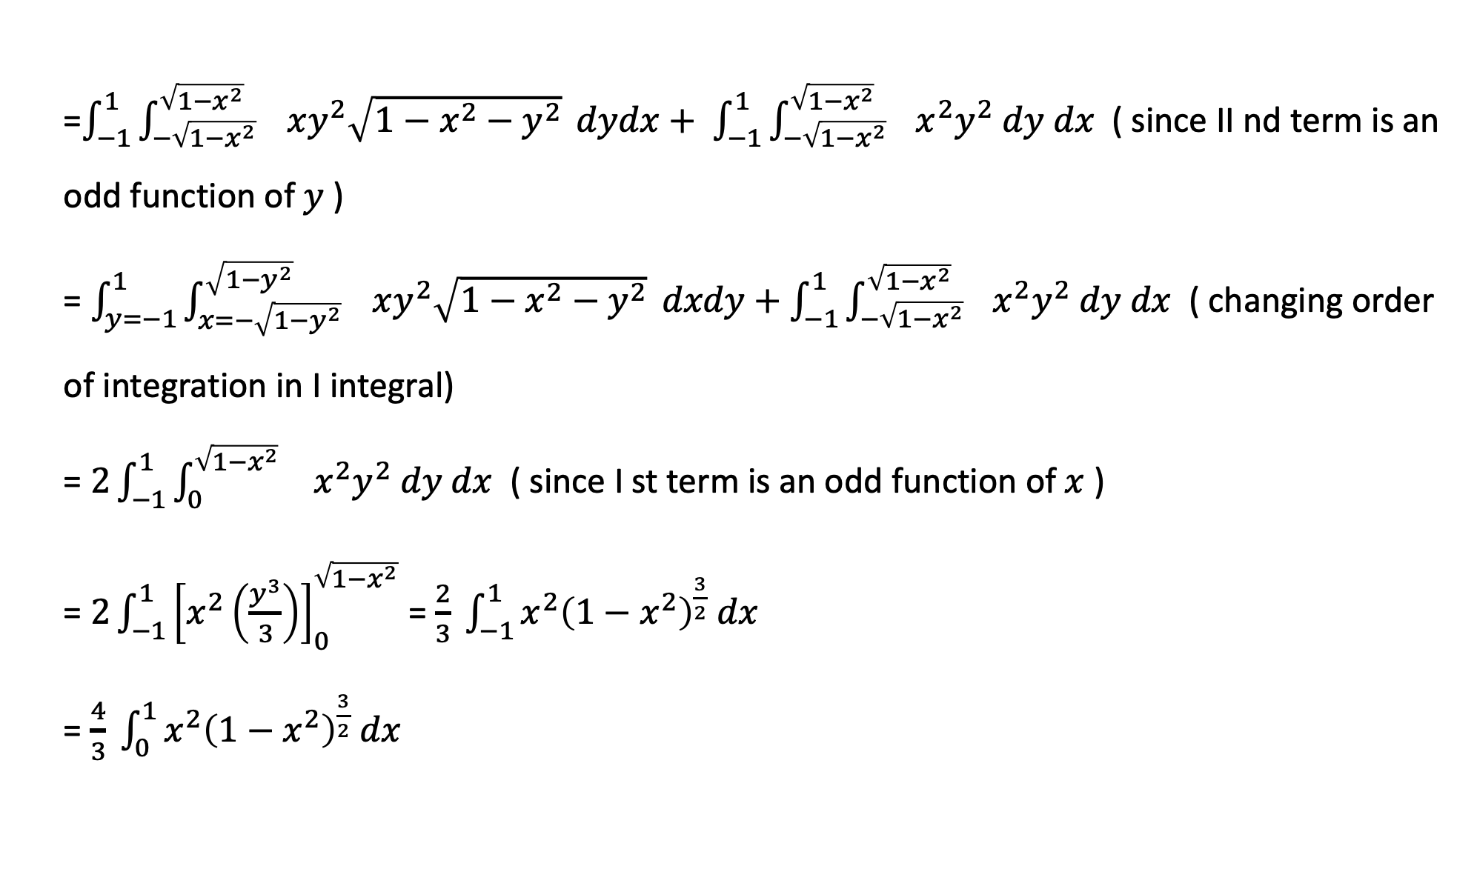
=$\int_{−1}^{1}{\int_{−\sqrt{1−x^{2}}}^{\sqrt{1−x^{2}} }{ xy^{2}\sqrt{1−x^{2}−y^{2}} }}dydx+ \int_{−1}^{1}{\int_{−\sqrt{1−x^{2}}}^{\sqrt{1−x^{2}} }{ }}x^{2}y^{2} dy dx$ ( since II nd term is an odd function of $y$ )
= $\int_{y=−1}^{1}{\int_{x=−\sqrt{1−y^{2}}}^{\sqrt{1−y^{2}} }{ xy^{2}\sqrt{1−x^{2}−y^{2}} }}dxdy+\int_{−1}^{1}{\int_{−\sqrt{1−x^{2}}}^{\sqrt{1−x^{2}} }{ }}x^{2}y^{2} dy dx$ ( changing order of integration in I integral)
= $2\int_{−1}^{1}{\int_{0}^{\sqrt{1−x^{2}} }{ }}x^{2}y^{2} dy dx$ ( since I st term is an odd function of $x$ )
= $2\int_{−1}^{1}{{\left[x^{2}\left(\frac{y^{3}}{3}\right)\right]}_{0}^{\sqrt{1−x^{2}}}}$ = $\frac{2}{3} \int_{−1}^{1}{x^{2}{\left(1−x^{2}\right)}^{\frac{3}{2}} dx }$
= $\frac{4}{3} \int_{0}^{1}{x^{2}{\left(1−x^{2}\right)}^{\frac{3}{2}} dx }$

Slide 14

Putting $x=\sin{θ}$ , we have $dx=\cos{θ}$ and for $x→\left(0,1\right), θ→\left(0,\frac{π}{2}\right).$
$∴\int{\int_{S}{\vec{F} . \vec{n} ds=\frac{4}{3} \int_{0}^{π/2}{\sin^{2}{θ .\cos^{4}{θ dθ}}} }}$
= $\frac{4}{3} \frac{Γ \left(\frac{3}{2}\right) .Γ \left(\frac{5}{2}\right)}{2 Γ\left(\frac{8}{2}\right)}$
= $\frac{4}{3} \frac{\frac{ 1}{2} \sqrt{π } × \frac{3}{2} .\frac{ 1}{2} \sqrt{π }}{2× \left(3!\right)}$
= $\frac{π}{24}$

Slide 15

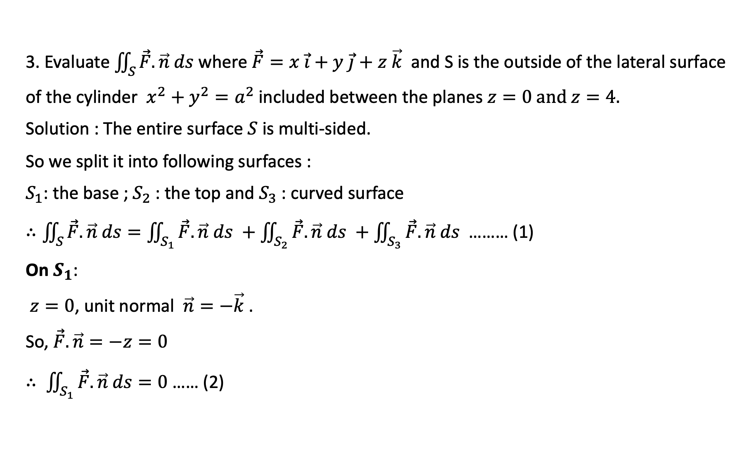


3. Evaluate $\iint_{S}{\vec{F}.\vec{n} ds }$where $\vec{F}=x \vec{i}+y \vec{j}+z \vec{k}$ and S is the outside of the lateral surface of the cylinder $x^{2}+y^{2}=a^{2}$ included between the planes $z=0 and z=4.$
Solution : The entire surface $S$ is multi-sided.
So we split it into following surfaces :
$S_{1}$: the base ; $S_{2}$ : the top and $S_{3}$ : curved surface
$∴\iint_{S}{\vec{F}.\vec{n} ds=\iint_{S_{1}}{\vec{F}.\vec{n} ds }+\iint_{S_{2}}{\vec{F}.\vec{n} ds }+\iint_{S_{3}}{\vec{F}.\vec{n} ds }}$ ……… (1)
On $S_{1}$:
$z=0$, unit normal $\vec{n}=−\vec{k}$ .
So, $\vec{F}.\vec{n}=−z=0$
$∴ \iint_{S_{1}}{\vec{F}.\vec{n} ds=0}$ …… (2)
Z
$$S_{2}$$
$$S_{3}$$
o
Y
$$S_{1}$$
X

Slide 16

On $S_{2}$ :
$z=4$, unit normal $\vec{n}=\vec{k}$ .
So, $\vec{F}.\vec{n}=z=4$
$∴ \iint_{S_{2}}{\vec{F}.\vec{n} ds=4} \iint_{S_{2}}{ds}$ = Area of $S_{2}$ i.e. area of circle $x^{2}+y^{2}=a^{2}$
Hence, $\iint_{S_{2}}{\vec{F}.\vec{n} ds=4}πa^{2}$ …… (3)

Slide 17
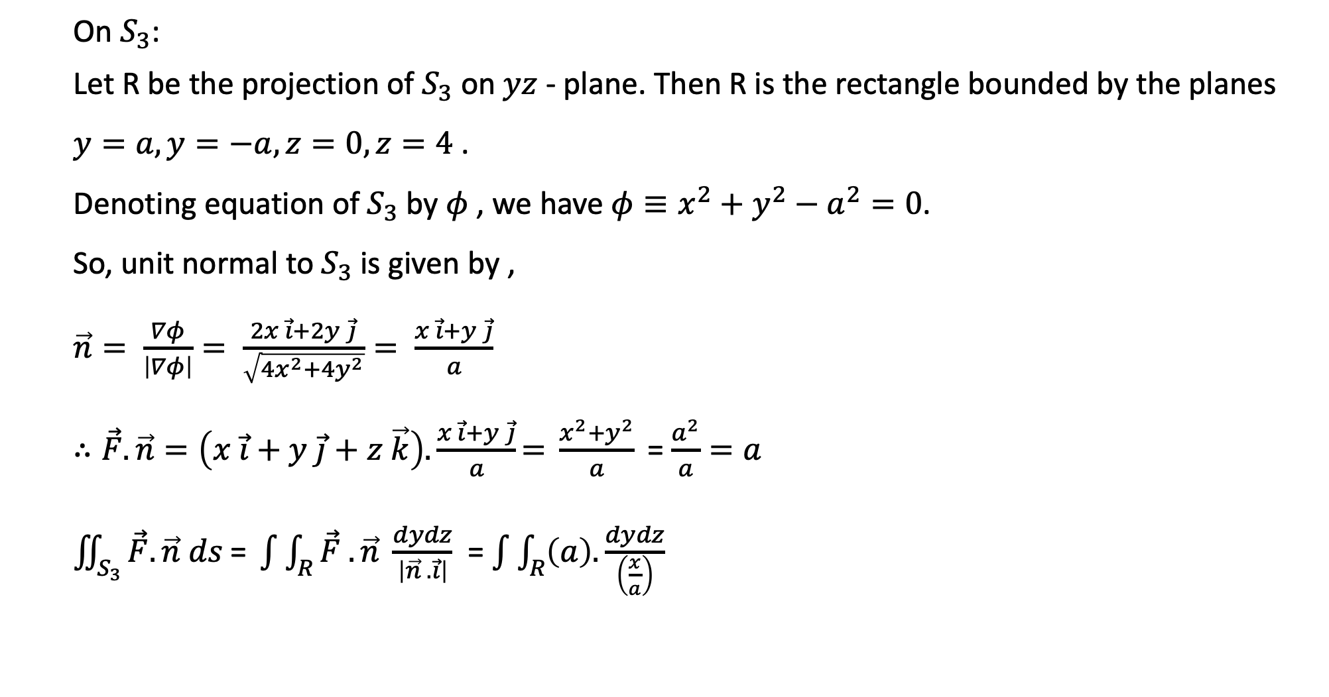
On $S_{3}$:
Let R be the projection of $S_{3}$ on $yz$ - plane. Then R is the rectangle bounded by the planes $y=a, y=−a, z=0, z=4$ .
Denoting equation of $S_{3}$ by $φ$ , we have $φ≡x^{2}+y^{2}−a^{2}=0$.
So, unit normal to $S_{3}$ is given by ,
$\vec{n}= \frac{∇φ}{\left|∇φ\right|}= \frac{2x \vec{i}+2y \vec{j}}{\sqrt{4x^{2}+4y^{2}}}= \frac{x \vec{i}+y \vec{j}}{a}$
$∴\vec{F}. \vec{n}=\left(x \vec{i}+y \vec{j}+z \vec{k}\right).\frac{x \vec{i}+y \vec{j}}{a}\text{= }\frac{x^{2}+y^{2}}{a} \text{=}$ $\frac{a^{2}}{a}=a$
$\iint_{S_{3}}{\vec{F}.\vec{n} ds \text{= }\int{\int_{R}{\vec{F} . \vec{n} \frac{dydz}{\left|\vec{n} . \vec{i}\right|}}}}$ = $\int{\int_{R}{\left(a\right).\frac{dydz}{\left(\frac{x}{a}\right)}}}$

Slide 18
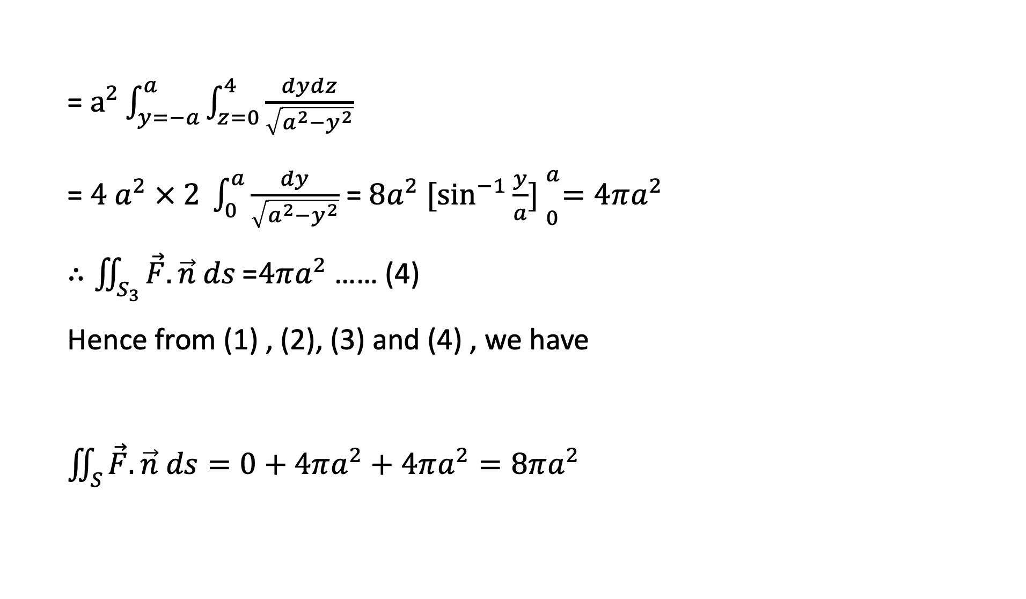
= $a^{2}\int_{y=−a}^{a}{\int_{z=0}^{4}{\frac{dydz}{\sqrt{a^{2}−y^{2}}}}}$
= $4 a^{2} × 2 \int_{0}^{a}{\frac{dy}{\sqrt{a^{2}−y^{2}}}}$ = $8a^{2} {[\sin^{−1}{\frac{y}{a}] }}_{0}^{a}=4πa^{2}$
$∴\iint_{S_{3}}{\vec{F}.\vec{n} ds \text{=}4πa^{2}}$ …… (4)
Hence from (1) , (2), (3) and (4) , we have
$\iint_{S}{\vec{F}.\vec{n} ds=0+4πa^{2}+4πa^{2}}=8πa^{2}$

Slide 19

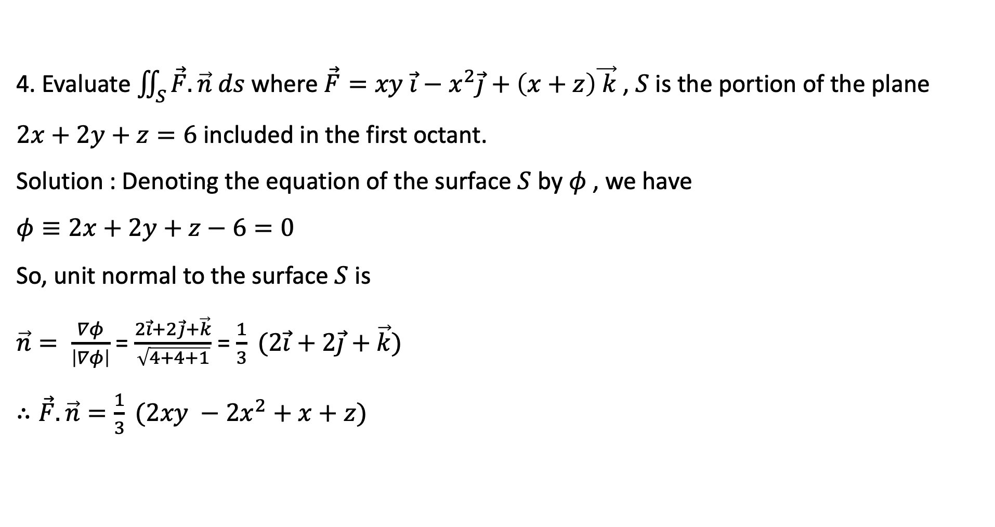
4. Evaluate $\iint_{S}{\vec{F}.\vec{n} ds }$where $\vec{F}=xy \vec{i}−x^{2}\vec{j}+\left(x+z\right)\vec{ k}$, $S$ is the portion of the plane $2x+2y+z=6$ included in the first octant.
Solution : Denoting the equation of the surface $S$ by $φ$ , we have
$φ≡2x+2y+z−6=0$
So, unit normal to the surface $S$ is
$\vec{n}= \frac{∇φ}{\left|∇φ\right|}$ = $\frac{2\vec{i}+2\vec{j}+\vec{k}}{\sqrt{4+4+1}}$ = $\frac{1}{3} (2\vec{i}+2\vec{j}+\vec{k})$
$∴\vec{F}.\vec{n}=\frac{1}{3} (2xy −{2x}^{2}+x+z)$
C(0,0,6)
o
B(0,3,0)
$$R:x+y=3,z=0$$
A(3,0,0)

Slide 20

Let R be the projection of S on $xy$- plane. Then R is :
$x+y=3, z=0$
In R , $x$ varies from 0 to 3 and $y$ varies from 0 to $3−x$ .
Also, $\vec{n} . \vec{k}=\frac{1}{3}$
$∴\int{\int_{S}{\vec{F} . \hat{n} ds}}\text{ = }\int{\int_{R}{\vec{F} . \vec{n} \frac{dxdy}{\left|\vec{n} . \vec{ k}\right|}}}$ ……….. (1)

Slide 21
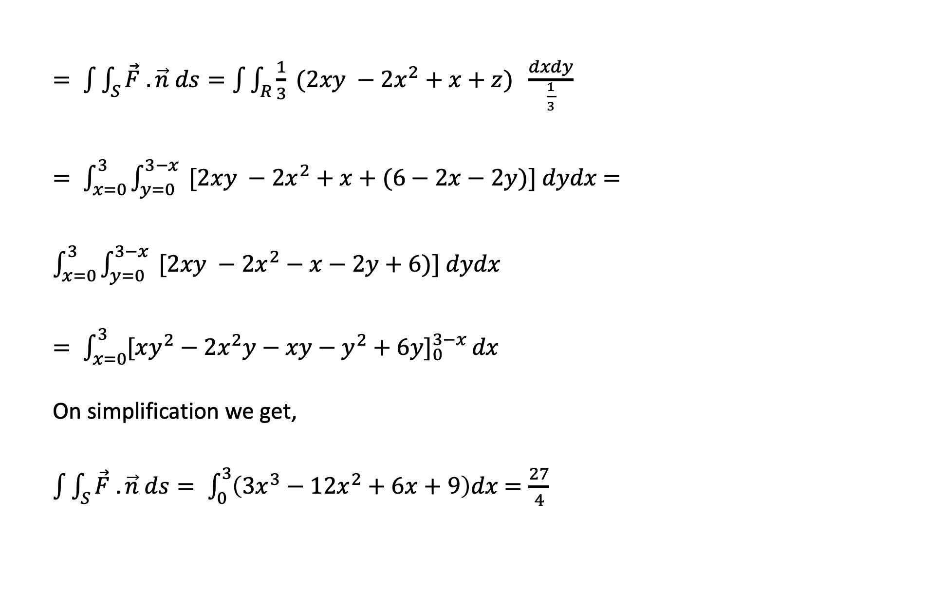
$= \int{\int_{S}{\vec{F} . \vec{n} ds}}=\int{\int_{R}{\frac{1}{3} (2xy −{2x}^{2}+x+z) \frac{dxdy}{\frac{1}{3}}}}$
$= \int_{x=0}^{3}{\int_{y=0}^{3−x}{ [2xy −{2x}^{2}+x+(6−2x−2y)}}] dydx$ $=\int_{x=0}^{3}{\int_{y=0}^{3−x}{ [2xy −{2x}^{2}−x−2y+6)}}] dydx$
$= \int_{x=0}^{3}{{[xy^{2}−2x^{2}y−xy−y^{2}+6y]}_{0}^{3−x}}dx$
On simplification we get,
$\int{\int_{S}{\vec{F} . \vec{n} ds}}= \int_{0}^{3}{\left(3x^{3}−12x^{2}+6x+9\right)dx}$ $=\frac{27}{4}$

Slide 22
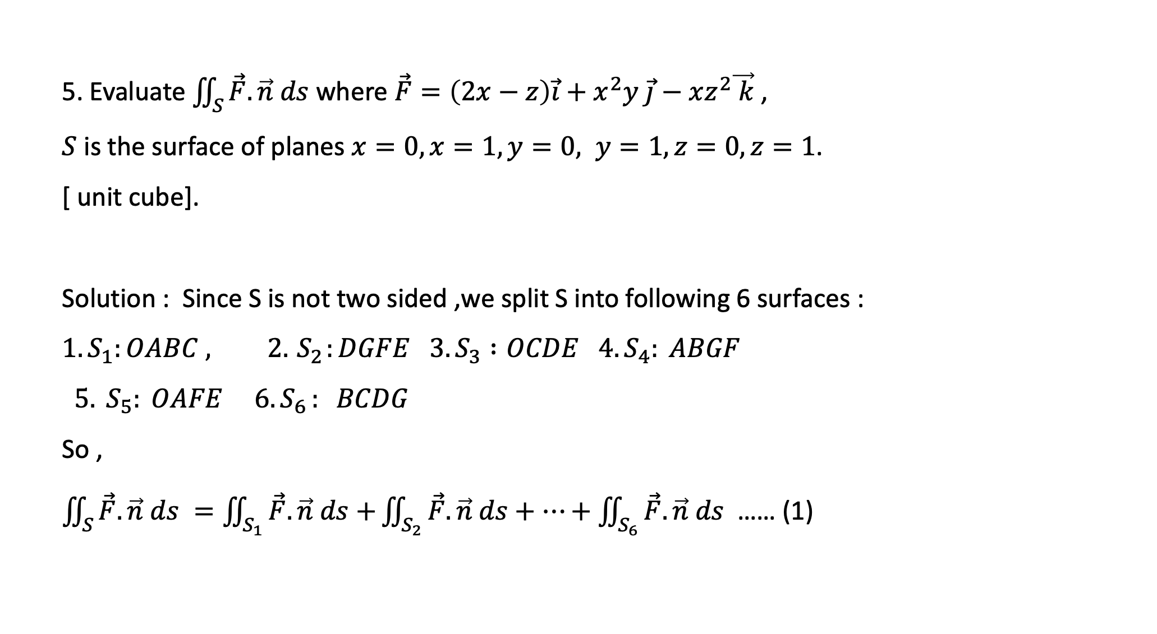
5. Evaluate $\iint_{S}{\vec{F}.\vec{n} ds }$where $\vec{F}=\left(2x−z\right)\vec{i}+x^{2}y \vec{j}−xz^{2}\vec{ k}$,
$S$ is the surface of planes $x=0,x=1, y=0, y=1,z=0,z=1$.
[ unit cube].
Solution : Since S is not two sided ,we split S into following 6 surfaces :
$${1. S}_{1}:OABC , 2. { S}_{2}:DGFE 3.S_{3} :OCDE 4. S_{4}: ABGF$$
$5. S_{5}: OAFE 6. S_{6 }: BCDG$
So ,
$\iint_{S}{\vec{F}.\vec{n} ds }=\iint_{S_{1}}{\vec{F}.\vec{n} ds+}\iint_{S_{2}}{\vec{F}.\vec{n} ds+…+\iint_{S_{6}}{\vec{F}.\vec{n} ds }}$ …… (1)
z
E
D
F
G
o
C
Y
A
B
X

Slide 23
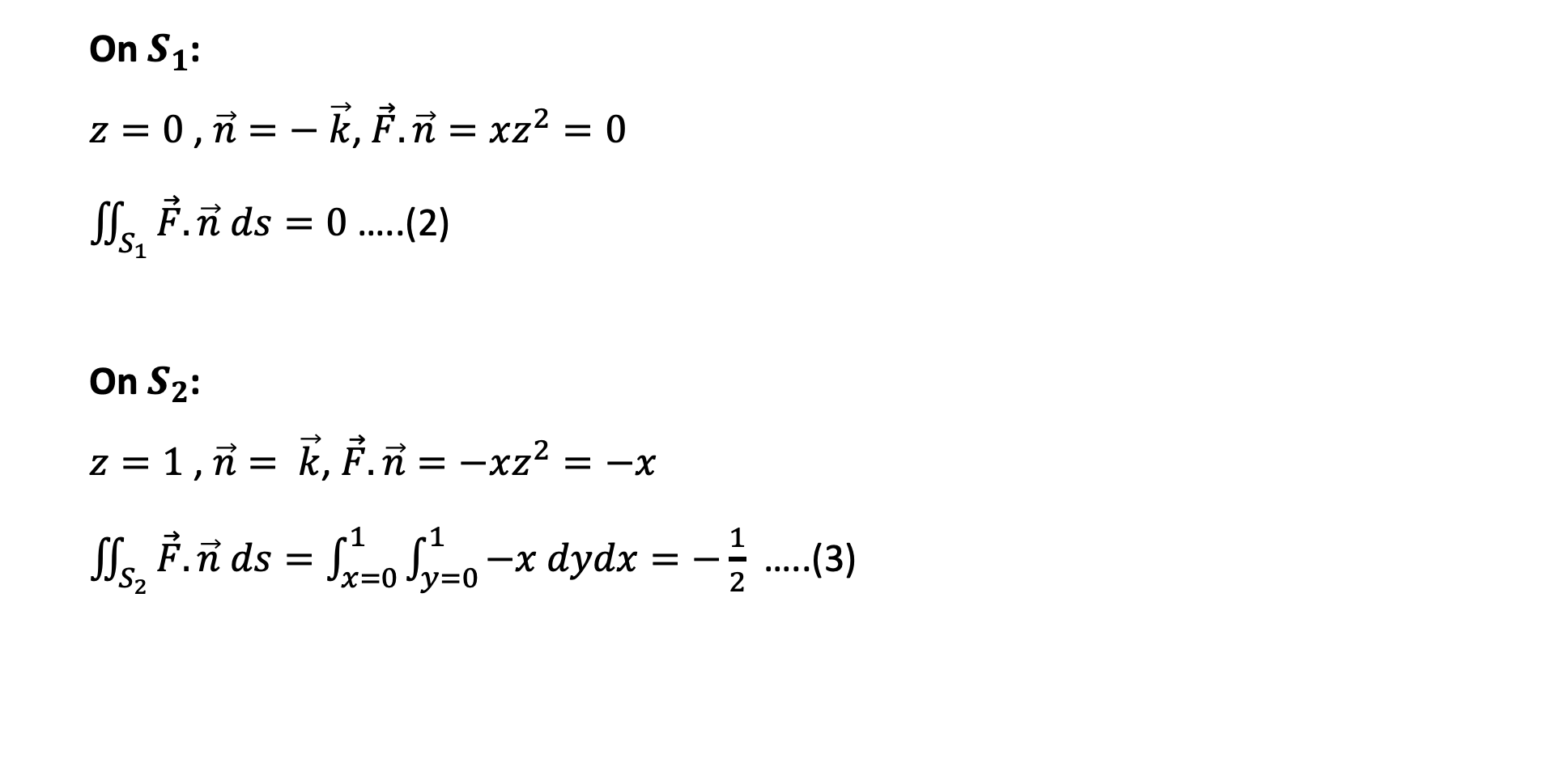
On $S_{1}$:
$z=0$ , $\vec{n}=− \vec{k}$, $\vec{F}.\vec{n}=xz^{2}=0$
$\iint_{S_{1}}{\vec{F}.\vec{n} ds=0}$ …..(2)
On $S_{2}$:
$z=1$ , $\vec{n}= \vec{k}$, $\vec{F}.\vec{n}=−xz^{2}=−x$
$\iint_{S_{2}}{\vec{F}.\vec{n} ds=\int_{x=0}^{1}{\int_{y=0}^{1}{−x dydx=−\frac{1}{2} }}}$ …..(3)

Slide 24
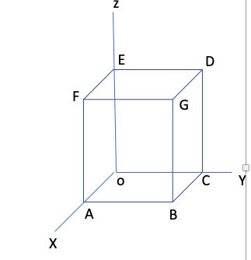
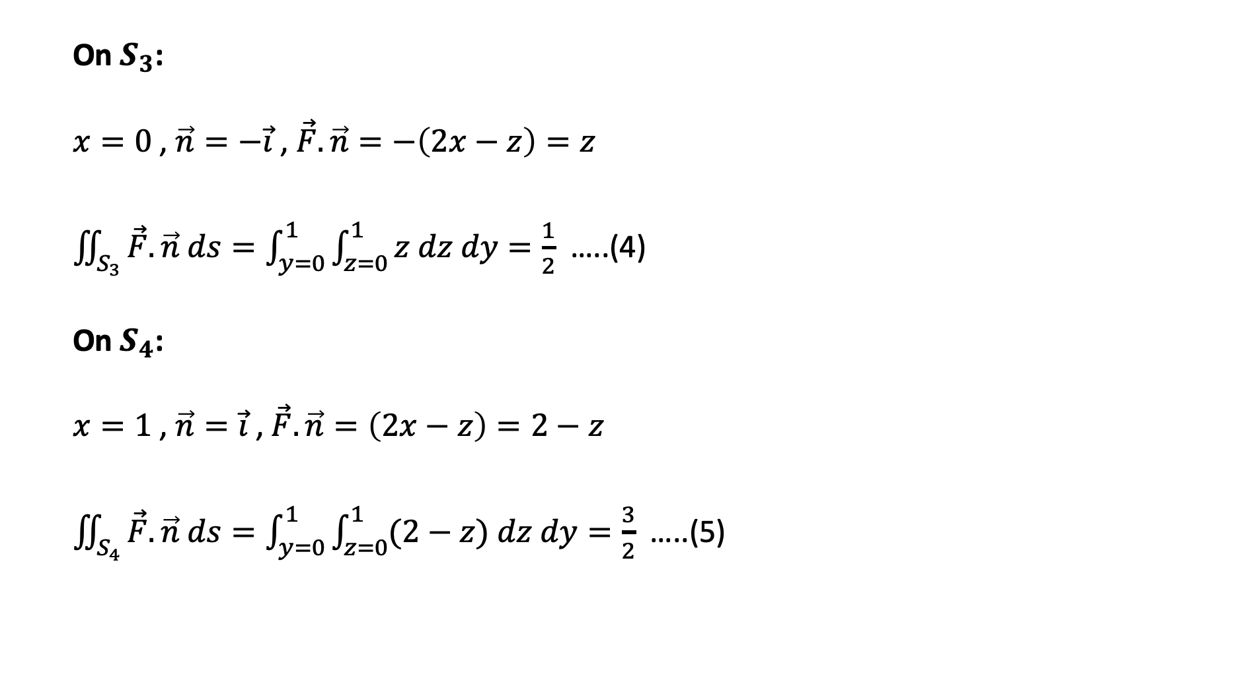
On $S_{3}$:
$x=0$ , $\vec{n}=−\vec{i}$, $\vec{F}.\vec{n}=−\left(2x−z\right)=z$
$\iint_{S_{3}}{\vec{F}.\vec{n} ds=\int_{y=0}^{1}{\int_{z=0}^{1}{z dz dy=\frac{1}{2} }}}$ …..(4)
On $S_{4}$:
$x=1$ , $\vec{n}=\vec{i}$, $\vec{F}.\vec{n}=\left(2x−z\right)=2−z$
$\iint_{S_{4}}{\vec{F}.\vec{n} ds=\int_{y=0}^{1}{\int_{z=0}^{1}{(2−z) dz dy=\frac{3}{2} }}}$ …..(5)

Slide 25
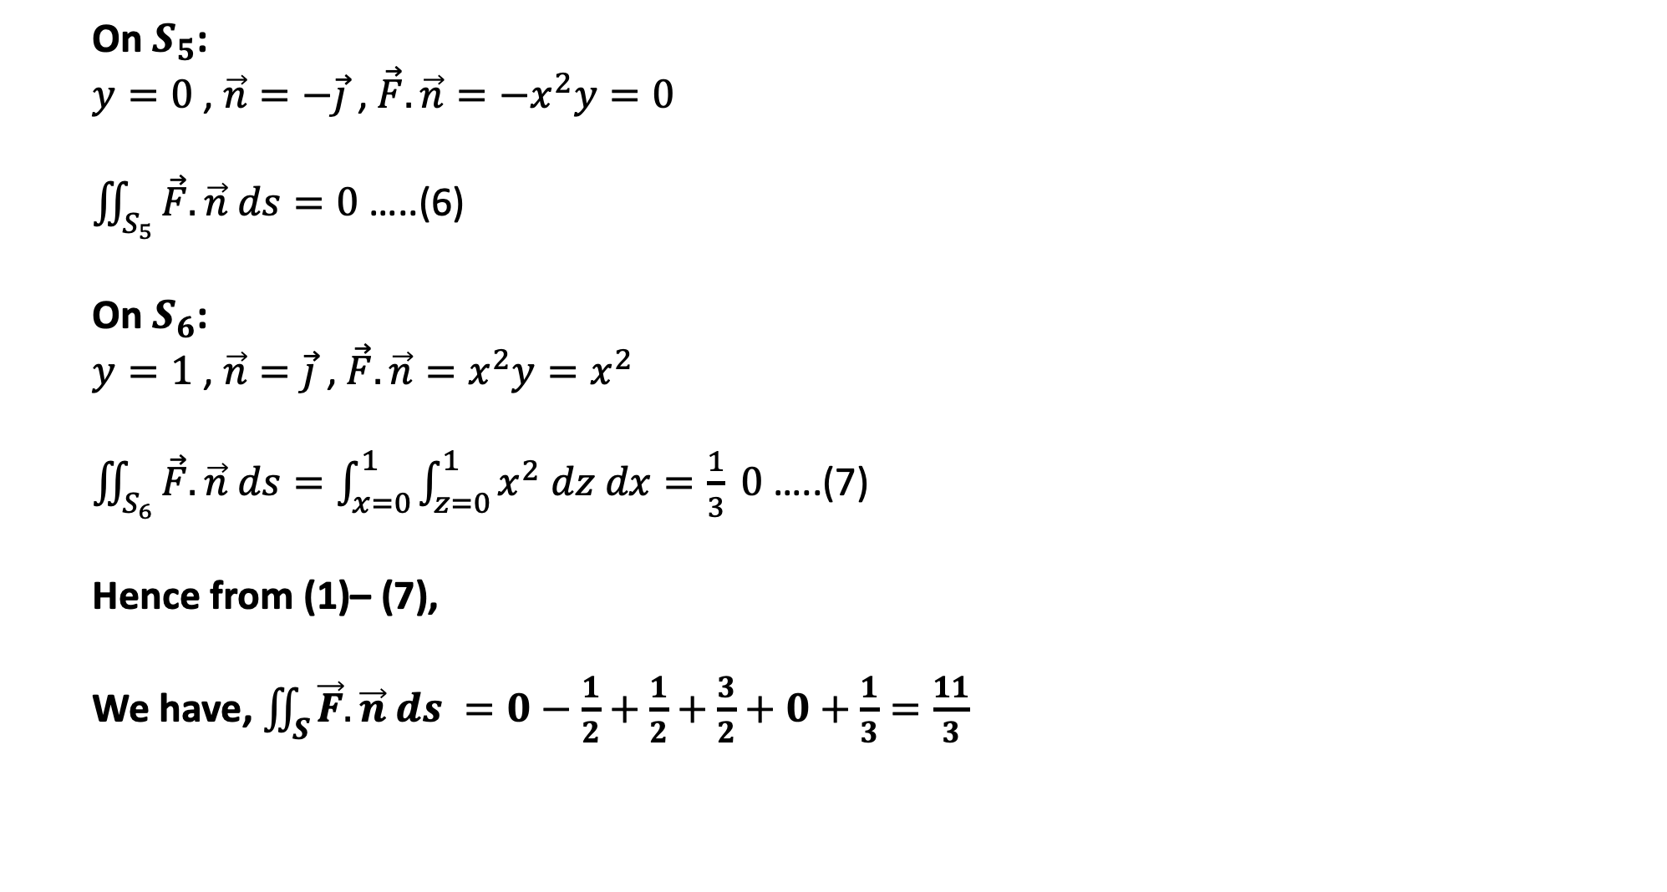
On $S_{5}$:
$y=0$ , $\vec{n}=−\vec{j}$, $\vec{F}.\vec{n}=−x^{2}y=0$
$\iint_{S_{5}}{\vec{F}.\vec{n} ds=0}$ …..(6)
On $S_{6}$:
$y=1$ , $\vec{n}=\vec{j}$, $\vec{F}.\vec{n}=x^{2}y=x^{2}$
$\iint_{S_{6}}{\vec{F}.\vec{n} ds=\int_{x=0}^{1}{\int_{z=0}^{1}{x^{2} dz dx=\frac{1}{3} }}0}$ …..(7)
Hence from (1)– (7),
We have, $\iint_{S}{\vec{F}.\vec{n} ds }=0−\frac{1}{2}+\frac{1}{2}+\frac{3}{2}+0+\frac{1}{3}=\frac{11}{3}$

Slide 26
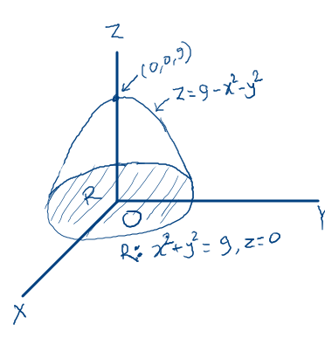

5. If S be the part of the surface $z=9−x^{2}−y^{2}$ with $z≥0$ and $\vec{F}=3x \vec{i}+3y \vec{j}+z \vec{k}$ , find the flux of $\vec{F}$through S.
Solution: Equation of surface S is:
$$φ ≡z−9+x^{2}+y^{2}=0$$
Therefore , unit normal to S is:
$$\vec{n}= \frac{∇φ}{\left|∇φ\right|}= \frac{2x \vec{i}+2y \vec{j}+\vec{k}}{\sqrt{4x^{2}+4y^{2}+1}}$$
So,
$$\vec{F} .\vec{n}= \frac{6x^{2}+6y^{2}+z}{\sqrt{4x^{2}+4y^{2}+1}}$$

Slide 27
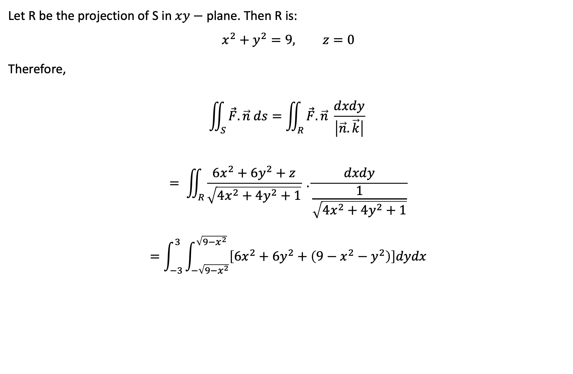
Let R be the projection of S in $xy−$ plane. Then R is:
$$x^{2}+y^{2}=9, z=0$$
Therefore,
$$\iint_{S}{\vec{F}.\vec{n} ds=\iint_{R}{\vec{F}.\vec{n} \frac{dxdy}{\left|\vec{n}.\vec{k}\right|} }}$$
$$= \iint_{R}{\frac{6x^{2}+6y^{2}+z}{\sqrt{4x^{2}+4y^{2}+1}} .\frac{dxdy}{\frac{1}{\sqrt{4x^{2}+4y^{2}+1}}}}$$
$$=\int_{−3}^{3}{\int_{−\sqrt{9−x^{2}}}^{\sqrt{9−x^{2}}}{\left[6x^{2}+6y^{2}+\left(9−x^{2}−y^{2}\right)\right]dydx}}$$

Slide 28
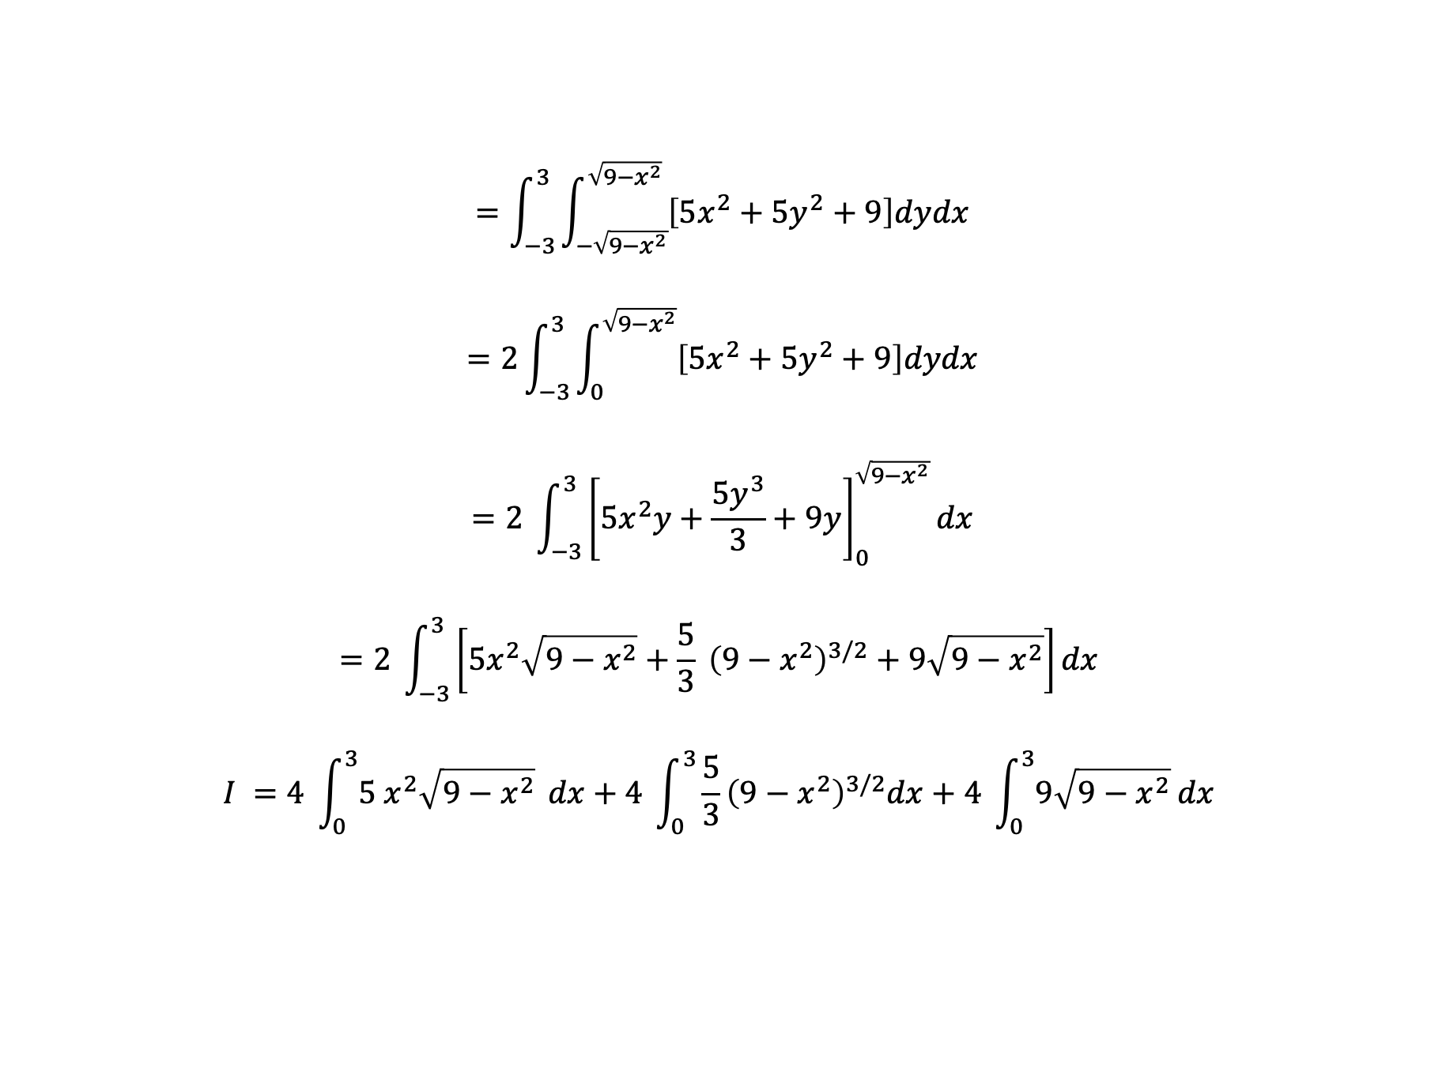
$$=\int_{−3}^{3}{\int_{−\sqrt{9−x^{2}}}^{\sqrt{9−x^{2}}}{\left[5x^{2}+5y^{2}+9\right]dydx}}$$
$$=2\int_{−3}^{3}{\int_{0}^{\sqrt{9−x^{2}}}{\left[5x^{2}+5y^{2}+9\right]dydx}}$$
$$=2 \int_{−3}^{3}{{\left[5x^{2}y+\frac{5y^{3}}{3}+9y\right]}_{0}^{\sqrt{9−x^{2}}}dx}$$
$$=2 \int_{−3}^{3}{\left[5x^{2}\sqrt{9−x^{2}}+\frac{5}{3} {\left(9−x^{2}\right)}^{3/2}+9\sqrt{9−x^{2}}\right]dx }$$
$$I =4 \int_{0}^{3}{{5 x}^{2}\sqrt{9−x^{2}}} dx+4 \int_{0}^{3}{\frac{5}{3}{\left(9−x^{2}\right)}^{3/2}dx}+4 \int_{0}^{3}{9\sqrt{9−x^{2}} dx }$$

Slide 29
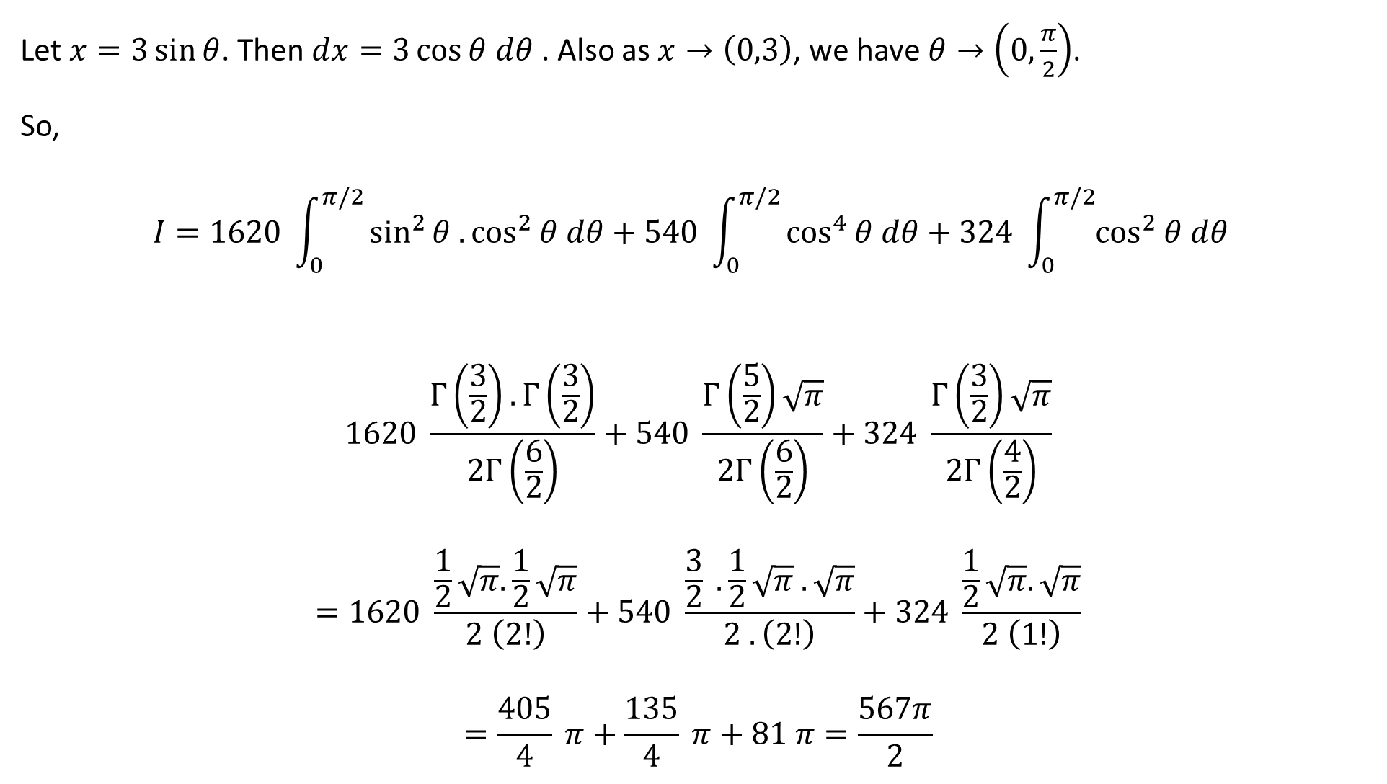
Let $x=3\sin{θ}$. Then $dx=3\cos{θ dθ}$ . Also as $x→\left(0,3\right)$, we have $θ→\left(0,\frac{π}{2}\right)$.
So,
$$I=1620 \int_{0}^{π/2}{\sin^{2}{θ .\cos^{2}{θ dθ+540 \int_{0}^{π/2}{\cos^{4}{θ dθ+324 \int_{0}^{π/2}{\cos^{2}{θ dθ }}}}}}}$$
$$1620 \frac{Γ\left(\frac{3}{2}\right).Γ\left(\frac{3}{2}\right)}{2Γ\left(\frac{6}{2}\right)}+540 \frac{Γ\left(\frac{5}{2}\right)\sqrt{π}}{2Γ\left(\frac{6}{2}\right)}+324 \frac{Γ\left(\frac{3}{2}\right)\sqrt{π}}{2Γ\left(\frac{4}{2}\right)}$$
$$=1620 \frac{\frac{1}{2}\sqrt{π}. \frac{1}{2}\sqrt{π}}{2 \left(2!\right)}+540 \frac{\frac{3}{2} .\frac{1}{2}\sqrt{π} . \sqrt{π}}{2 .\left(2!\right)}+324 \frac{\frac{1}{2}\sqrt{π}. \sqrt{π}}{2 \left(1!\right)}$$
$$=\frac{405}{4} π+\frac{135}{4} π+81 π=\frac{567π}{2}$$

Slide 30

Alternatively
$$∇.\vec{F}=\left(\vec{i}\frac{∂}{∂x}+\vec{j}\frac{∂}{∂y}+\vec{k}\frac{∂}{∂z}\right).\left(3x \vec{i}+3y \vec{j}+z \vec{k}\right)=3+3+1=7$$
Now the surface $S:x^{2}+y^{2}+z=9$ encloses the volume. Hence we can apply Gauss Divergence theorem.
Hence, $\iint_{S}{\vec{F}.\vec{n}= \iiint_{V}{\left(∇.\vec{F}\right) dV}}$
$=\iiint_{V}{7 dV}$
$=7\iiint_{V}{ dV}\text{= 7}\text{V}$
$=7×$ Volume of the paraboloid
$=7×\left(\frac{1}{2} πr^{2}h\right)$
$=7×\left(\frac{1}{2} π. 3^{2}. 9\right)=\frac{567}{2}π$

